Slide 1
Planit!
Get Stuff Done
Planit.proj6.com
Beth VanBelle Devin Gleason-Lambert Alberto Beltran
Notes:
We're creating a web based tool that simplifies planning your projects, and scheduling your time so that you stay motivated to finish.
Introduce the team

Slide 2
Objectives
Problem Specification
Solution Process/Design
Tools List
Time Schedule
List of Deliverables
Grading Scheme
Notes:
Our team objectives are .. .

Slide 3
Objectives
Team
Real World Software Development Process
Object-Oriented Analysis and Design
Remote/Local, Individual/Group Project Collaboration
Albert
User Interface Design
Learn Visual Studio / C#
Beth
Use C# in a Real Project
Implement a Group Project
Devin
Object-Oriented Implementation
.NET Stack
Notes:
<Devin Objectives, 4>
My objectives for the project were pretty simple, I wanted to create software that wouldn’t be thrown away at the end of the semester.
<Next/>
Next I want to build on my knowledge of object orientation, because I believe in the methodology and my plan is to continue using it after college,
<Next/>
And last I want to learn and use the .NET stack because it’s a qualification I want based on the job searching I have done,
And honestly I just don’t want to work with open source software
</Devin Objectives, 4>

Slide 4









Tools List
Notes:
As I had said previously a personal objective for me was to learn the .NET Stack
<Next>
and as you can see we list C#, Visual Studio, and .NET
<Next>
for the front end we plan on using JavaScript and JQuery for visually appealing dynamic web pages,
<Next>
our backend following the Microsoft stack will be SQL Server,
<Next>
and last for design we plan on using Dreamweaver for well laid out pages.
<Next>
Oh and lets not forgot Pizza and Google
</Devin Tools List, 14>
Beth

Slide 5
















Notes:
As I had said previously a personal objective for me was to learn the .NET Stack
<Next>
and as you can see we list C#, Visual Studio, and .NET
<Next>
for the front end we plan on using JavaScript and JQuery for visually appealing dynamic web pages,
<Next>
our backend following the Microsoft stack will be SQL Server,
<Next>
and last for design we plan on using Dreamweaver for well laid out pages.
<Next>
Oh and lets not forgot Pizza and Google
</Devin Tools List, 14>
Beth

Slide 6
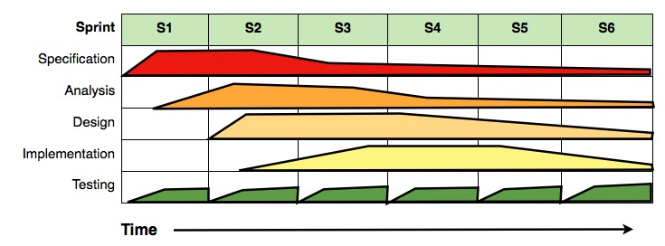
Time Schedule
Notes:
workflow chart - This work has been released into the public domain by its author, Dutchguilder at the projectname project. This applies worldwide.
2 week sprints

Slide 7
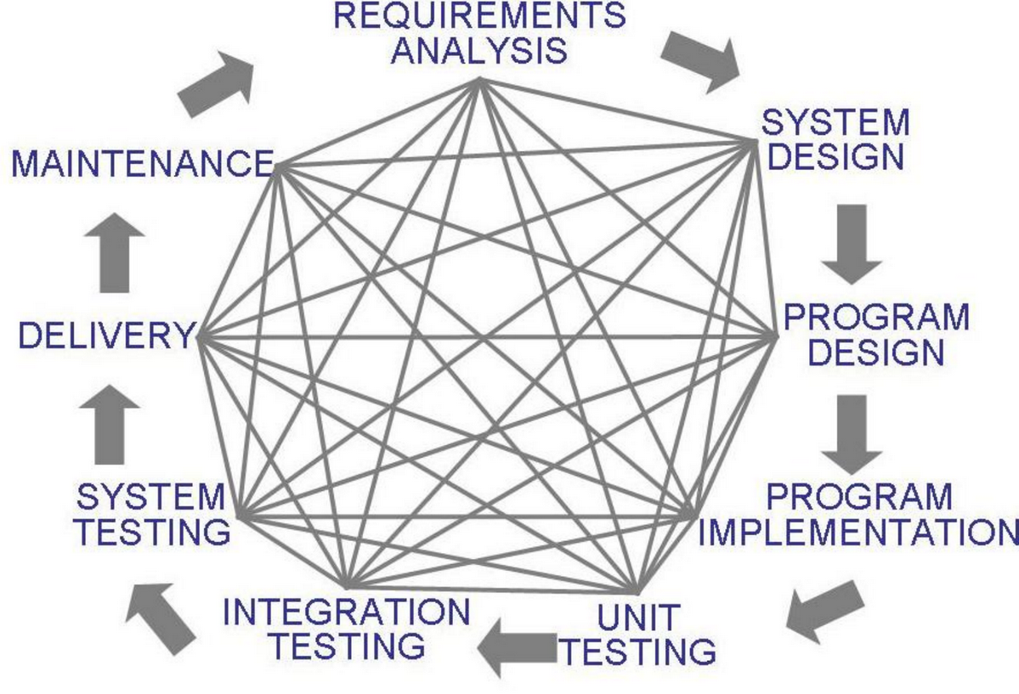
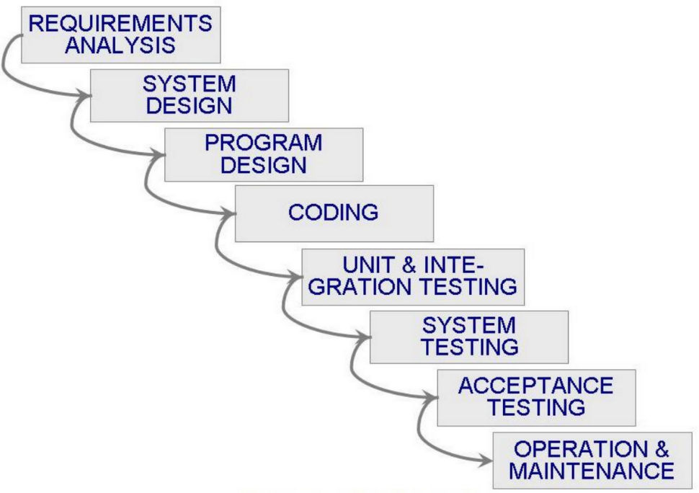
Workflow
On some level we expected.
What happened.
Notes:
workflow chart - This work has been released into the public domain by its author, Dutchguilder at the projectname project. This applies worldwide.
2 week sprints

Slide 8
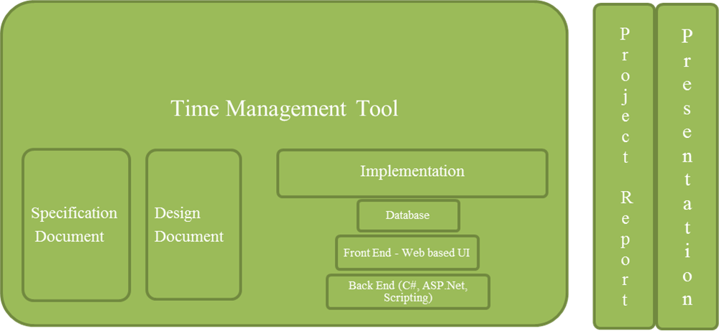
List of Deliverables
Notes:
website
functionality
From Beth:
If you explain at the beginning that there are uncertainties and show how there is a range of time that you expect these things to be done in, then when you reevaluate you should be more certain and have a better view of how long it's going to take so that the time range should be more narrow. We need to acknowledge during the presentation that the first couple of sprints are experimental and will have a better feel of what we can acomplish.

Slide 9
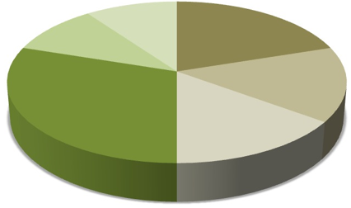
Grading Scheme
10%
20%
10%
15%
30%
15%
Notes:
We assigned specification 20% because we felt it was one of the most important parts of our project and considering we all took the software engineering track we were able to understand its importance.
<Next/>
Following up with analysis we assigned it a slightly smaller number because we didn’t feel it was as important as specifications but at the same time we felt pulling out our classes and having a good understanding of the functional flow was important for scalability and maintainability in later workflows.
<Next/>
Design was given the same level of effort as analysis because at this point we will have already spent half of our time on planning, so continuing to make sure we keep on track and work on our design before implementation seemed appropriate.
<Next/>
Implementation came in at 30%. Although the largest individual assignment, we have still assigned the majority of the project to planning.
<Next/>
Documentation has earned it's self 10% because as a real world software experience we understand that in order for a group to function properly, we can’t be wasting our time trying to understand what our colleague’s code is supposed to do.
<Next/>
And finally we have assigned our presentation 10% because our goal is to not just to deliver a piece of software but deliver a quality and engaging product presentation.

Slide 10
Planit!
We’re Here to Help
Notes:
We would like to thank you for your time, and this brings us to the conclusion of our presentation. Do we have any questions?

Slide 11
Choosing the Project Framework
Doing the first walkthrough of deploying to Azure
Integrating JQuery plugins into MVC project
Integrating javascript code into MVC/Razor/Html Model
The GIT Bash Learning curve - Living in GITHub and working in GIT
Database
Integrating the MVC “free” User Authentication
No change is a standalone change
Sprints, deadlines, formal testing and documentation – not so much….
Scheduling, Teamwork and meetings
Beta Testing by Family and Friends
What would we do differently?

Slide 12
Backlog
project search box | Humorous 404 page...you are not in github anymore Dorothy | if still logged in, redirect to tree view
zoom in, zoom out project search, think ggogle maps, i know the street the house is on... | Create Unit Tests | Clean up access modifiers.....
more information in explore area, sample projects | Schedule and tree view displays ' as #39 | Edit View show set dates, don't show date format
Public repository to share projects with other users | Create users and data for demo | Change Planit.Core from an Application to a Library
space for project in process pictures, notes | Data Validation Rules | DueDate/StartDate default to 12AM Make improvements
Share completion on facebook | Put restrictions on root, can't edit or complete, etc | Add horizontal scrolling to Outline view
Oauth facebook, google etc | Make Glyphicons in tree/outline/task consistent | Dispose Method on projectcontrller is commented out
When task is completed, fireworks, congratulations... | Improve Root default values | Tree view javascript has maximumId = 500...don't know what this does.
better tree navigation, grab drag and drop | Add edit to tree view | Project ID count has jumped...is there a max and how do we reset
Project hours invested. So far we only have calendar time | Make completed projects View. | Organize, Bundle, Minify Javascript

Slide 13
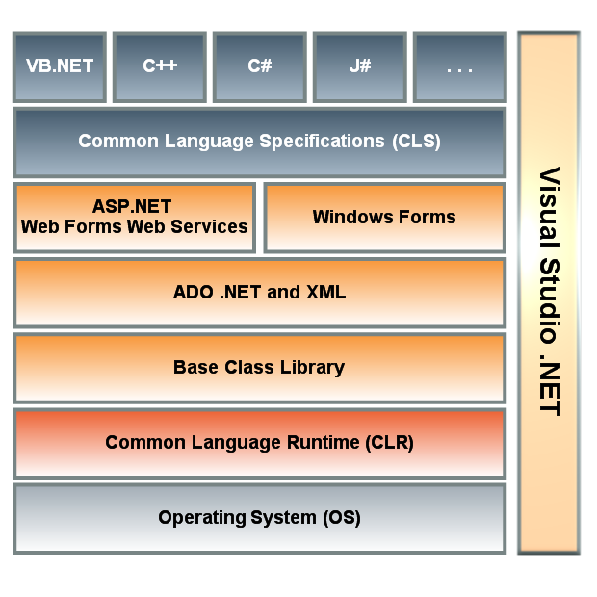

Slide 14
